Slide 1


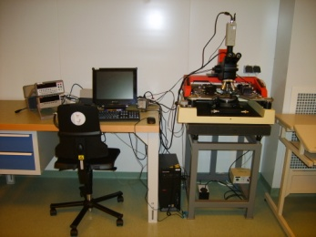
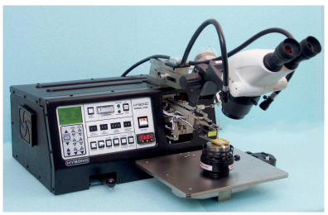
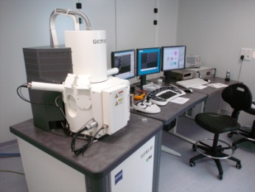
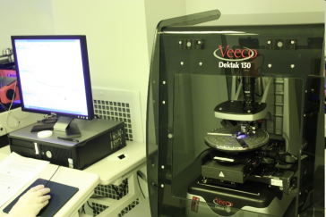
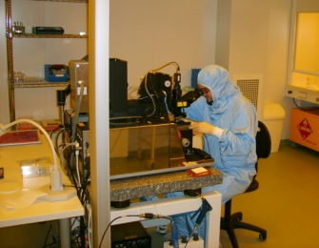
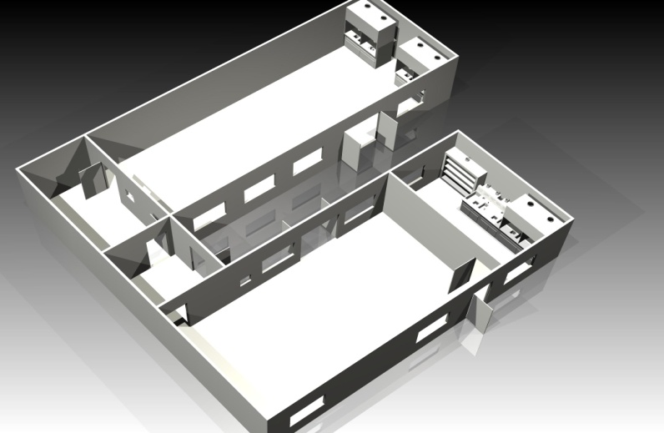
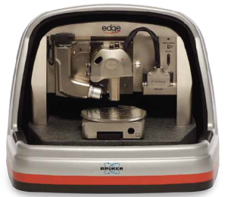
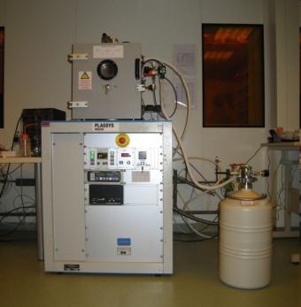
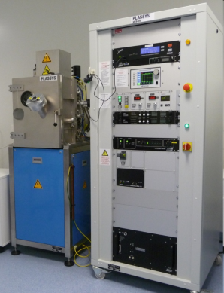
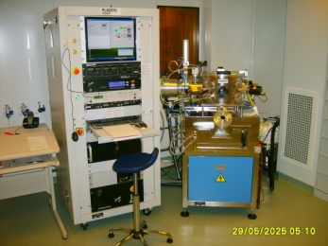
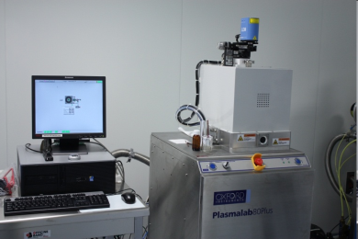
STnano
Nanofabrication Facility
4 Probes station (Karl Suss PM8)
Wire bonder (wedge and ball bonding)
e-beamLithograpy : SEM Zeiss Supra 40 + Raith Elphy Plus
3D Profilometer (Dektak 150)
Student Lab
UV Lithography : MJB4
Aligner
Back
end
Litho room
Sas
Process Lab
106 m² ISO class 5
63 m² ISO class 6
Bruker Dimension Edge AFM:
AFM, MFM, PFM, C-AFM
Thermal Evaporator (Cr, Al, Au, Ag) with sample holder cooled with liquid notrogen
Sputtering dedicated to dielectric thin films (SiO₂, Si₃N₄, Al₂O₃)
e-beam evaporator for metals (Al, Py, Co, Au, Ni, Ti) with ion gun for pre-etching
PlasmaLab RIE-ICP: Fluorine Reactive ion etcher

